Slide 1

BCB430Y Research Project Plasma-treated Sorghum bicolor RNA-Seq Analysis
Presenter: Fangyi Li
Advisory Team:
Professor Nicholas J. Provart
Professor Takamasa Okumura
Professor Eiji Nambara
Vincent Lau, Msc.
Notes:
Hi, my name is Fangyi; for my BCB430 research project, I worked to conduct an RNA-seq analysis on sorghum bicolor to explore the effects of plasma treatment.

Slide 2
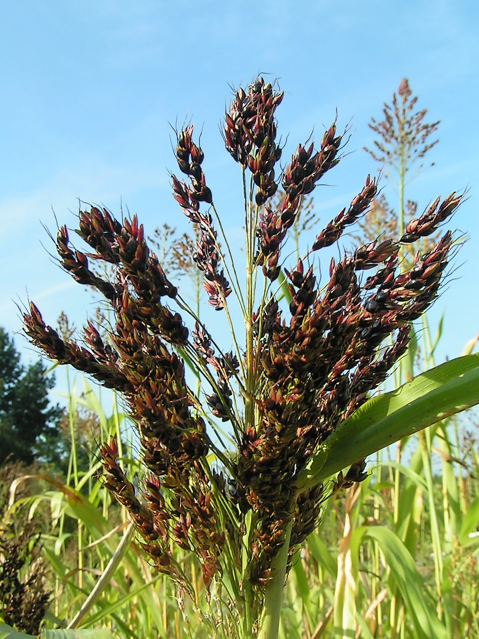
Sorghum bicolor
Versatile grain
Drought tolerant
Nutrient-rich (high sugar content)
Biofuel potential (high biomass)
Figure 1. Sorghum bicolor by Botanical Gardens Utrecht University (2005)
Notes:
This is just a little introduction to Sorghum bicolor, commonly named sorghum. Sorghum is a versatile cereal grain that has been cultivated for thousands of years. It is known for its resilience to drought, heat, and poor soil conditions, making it an essential staple food for millions of people.
Certain varieties of sorghum, known as sweet sorghum, are cultivated specifically for their elevated sugar levels. These sugars can be extracted and utilized in various ways, including as a source for biofuel production or as a sweetening agent in food and beverage industries. The high sugar content in sweet sorghum makes it an attractive option for renewable energy production, offering a sustainable alternative to traditional fossil fuels.
Sorghum is also known for its ability to produce a significant amount of biomass, referring to the total plant material that can be harvested. This biomass can be utilized for many purposes, including as animal feed and raw material for bioenergy production.

Slide 3

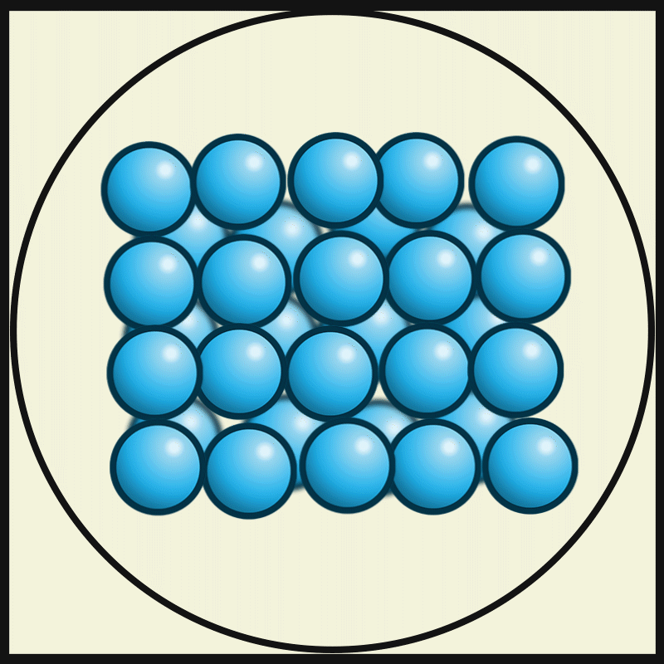
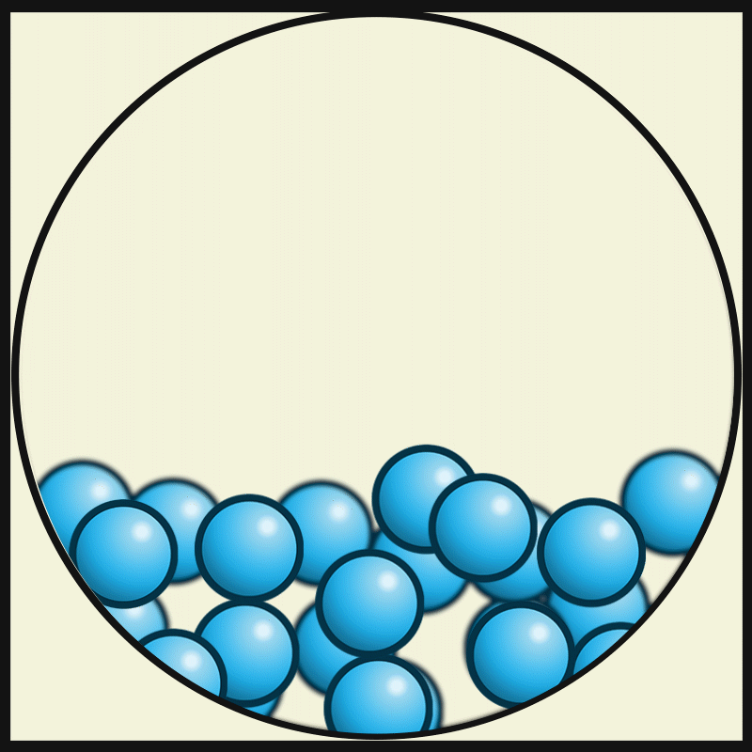
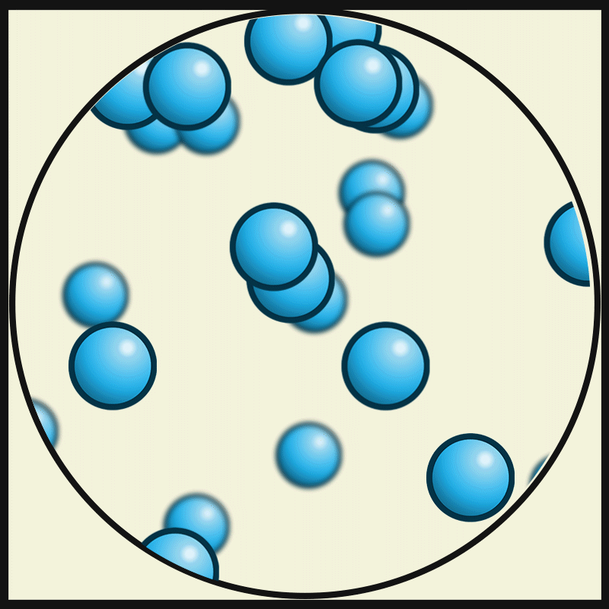
Plasma
4th state of matter
Mixture of ions, electrons and neutral particles
Cold plasma applications in agriculture
(a) Solid
(b) Liquid
(c) Gas
Figure 2. Illustration of particles in the (a) solid state, (b) liquid state and (c) gas state, created by Tecnológico de Monterrey (2017)
Figure 3. Artificial plasma produced in air by a Jacob's Ladder (2010)
Notes:
You might have heard about the three states of matter before: solid, liquid, and gas, with an energy level from low to high. Plasma is often called the fourth state of matter. It’s a mixture of ions, electrons, and neutral particles.
Plasma is usually extremely hot and highly energetic, but cold plasma was invented. It might sound contradictory. But it’s real and incredibly useful. You can imagine it like a gentle breeze of charged particles.
In medicine, cold plasma has shown promise in wound healing by disinfecting wounds without damaging surrounding tissue.
In agriculture, cold plasma has shown potential in stimulating seed germination, disinfecting surfaces and controlling pests and pathogens in many species. Therefore, we would like to explore how plasma treatment would affect sorghum’s growth.

Slide 4
Data
Dry Seed
1-day Imbibed Seed
4-week Shoot
x 3 replicates each
1-day Imbibed Seed
4-week Shoot
RNA Sequencing (Pair-end)
5 Conditions & 15 Replicates (FASTQ reads)
= Plasma Treatment
Notes:
The first step was to get our data.
We first have a bunch of sorghum seeds subjected to controlled imbibition conditions to stimulate natural germination processes. Half of them got plasma treatment during germination. Then, we sampled some of them for sequencing. Some were replanted and grown for 4 weeks so we could also collect the shoot tissues for sequencing.
It is important to note that shoots were not directly subjected to plasma treatment. Instead, they were grown from seeds that had undergone either plasma or no treatment.
The dry seed sample sequencing data came from a previous sorghum study at NCBI, the National Center for Biotechnology Information.
For each condition, we had 3 replicates. So, in total, we have 5 conditions and 15 replicates. All of them went through pair-end RNA sequencing, and we have 15 sample reads in the FASTQ format at the end.

Slide 5

Read Alignment – HISAT2
FASTQ_1
.
. x 15
.
BAM_1
FASTQ_15
HISAT2
Samtools
.
. x 15
.
GTF annotation
BAM_15
FASTA reference
Notes:
Next, we did the read alignment with a tool called HISAT2.
It requires not only the FASTQ reads we RNA sequenced but also two other files.
One is the sorghum bicolor annotation file in the GTF format. GTF annotation stores information about gene features like exons, introns, coding sequences, and untranslated regions.
The other is the sorghum reference file in the FASTA format. The FASTA reference contains the whole genomic assembly.So HISAT2 took these 3 kinds of files as inputs and aligned them into SAM files.
Then, another tool, called samtools, converted and sorted those SAM files into BAM files for later analysis.
The whole process was done in the bash environment.

Slide 6

Read Counting – Rsubread::featureCounts
BAM_1
.
. x 15
.
featureCounts
Raw Count Matrix
BAM_15
GTF annotation
Notes:
After aligning the sequencing reads to the reference genome, the next step was quantifying the number of reads aligned to each genomic feature.
So, we input those bam files and the same GTF annotation file into the R environment. We mainly used a function called featureCounts for read counting. It’s from the package Rsubread and is known for its accuracy and efficiency. Converting those SAM files to sorted BAM files speeded up the overall process.
What we got was a raw count matrix that was essential for later differential gene expression analysis. In this count matrix, each row represented a genomic feature or so-called gene, and each column represented a sample like seed_plasma_1, seed_plasma_2, and so on.

Slide 7
Differential Expression Analysis – DESeq2
PCA,
MA Plots,
Volcano Plots
Raw Count Matrix
DESeq2
Up & Down-regulated Genes
Comparison | # of Up-regulated Genes | # of Down-regulated Genes
Seed WT vs. Dry | 4737 | 6852
Seed WT vs. Plasma | 1976 | 3603
Shoot WT vs. Plasma | 0 | 0
Notes:
Next, using the count matrix, we conducted differential expression analysis with DESeq2. DESeq2 is a powerful R package used to identify genes significantly differentially expressed between experimental conditions.
Based on the DESeq2 result, we were able to create PCA, MA and volcano plots. We will look into these plots one by one in the next few slides.But more importantly, we could produce up and down-regulated gene lists for later functional analysis. In the DESeq2 result, we extracted differential expressed genes with a p-value greater than 0.05. In this set, we identified genes with a log2 fold change greater than 1 as up-regulated genes and genes with a log2 fold change less than -1 as down-regulated genes.
Here’s a table of the number of up- and down-regulated genes for each comparison. When we compare seed wild-type and seed dry conditions, we have 4737 up-regulated genes and 6852 down-regulated genes. And when we compare seed wild-type to seed plasma conditions, we have 1976 up-regulated genes and 3603 down-regulated genes. What’s interesting is that no up and down-regulated genes are detected when we examine the shoot wild-type and shoot plasma conditions.

Slide 8
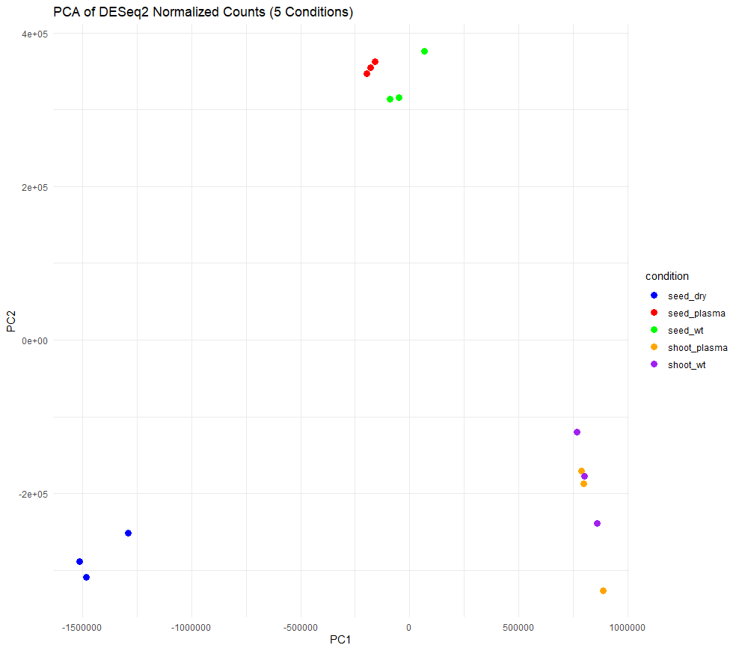
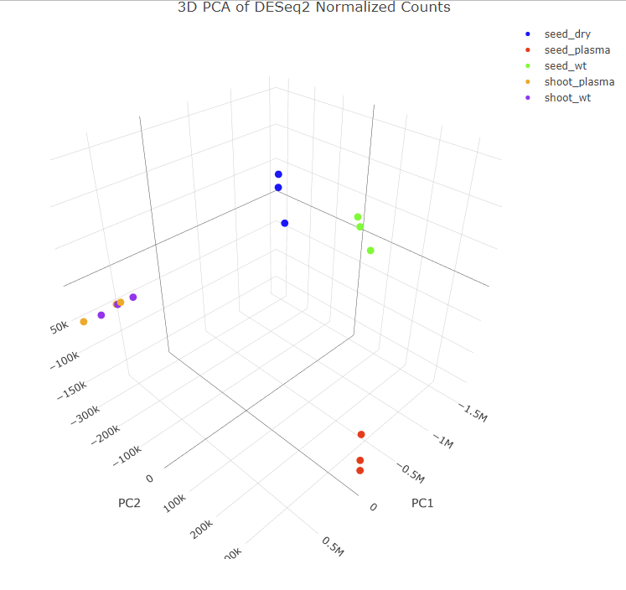
DESeq2 – PCA
Figure 4. 2D PCA plot of DESeq2 normalized counts.
Figure 5. 3D PCA plot of DESeq2 normalized counts.
Notes:
In order to visualize the overall patterns of variation in gene expression across samples, we conducted principal component analysis on the DESeq2 normalized counts.
What’s on the left is a 2-dimensional PCA plot. Each colour represents a condition, and we have 3 replicates for each condition, so 3 dots per colour. We see that 3 blue dots cluster on the bottom left, which are the dry seed samples. Red dots and green dots each form a cluster, but they are very close. Red dots are plasma-treated seed samples, and green dots are the wild-type seed samples. We can also discover that orange and purple dots seem tangled together. Orange dots are plasma-treated shoot samples, and purple dots are wild-type shoot samples.
However, we were not 100% sure because they may seem to overlap in 2D but separate in 3D. So, we created another PCA plot but in 3D. In this plot, we can confirm that blue, red and green dots each form a cluster by themselves. And orange and purple dots actually tangle together. This means dry seeds, plasma-treated seeds and wild-type seeds are different from one another, but there’s no significant difference between plasma-treated shoots and wild-type shoots.

Slide 9
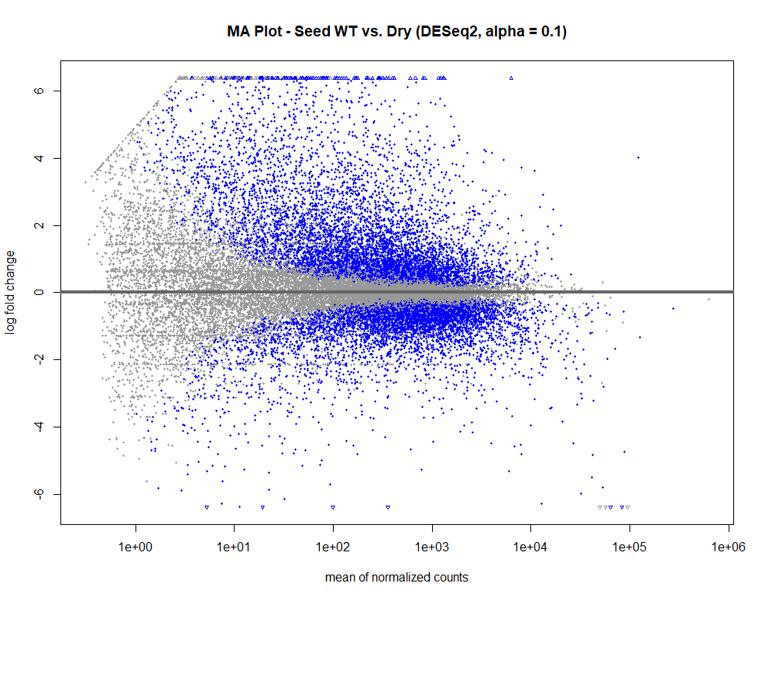
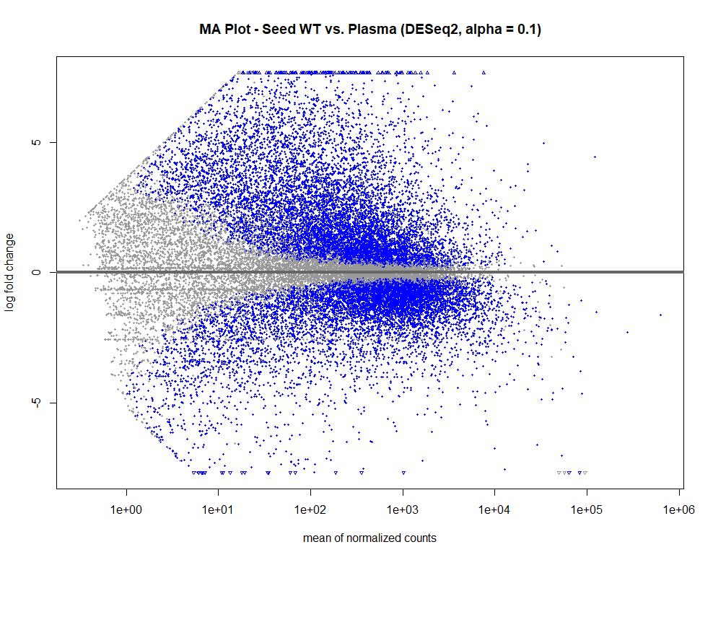
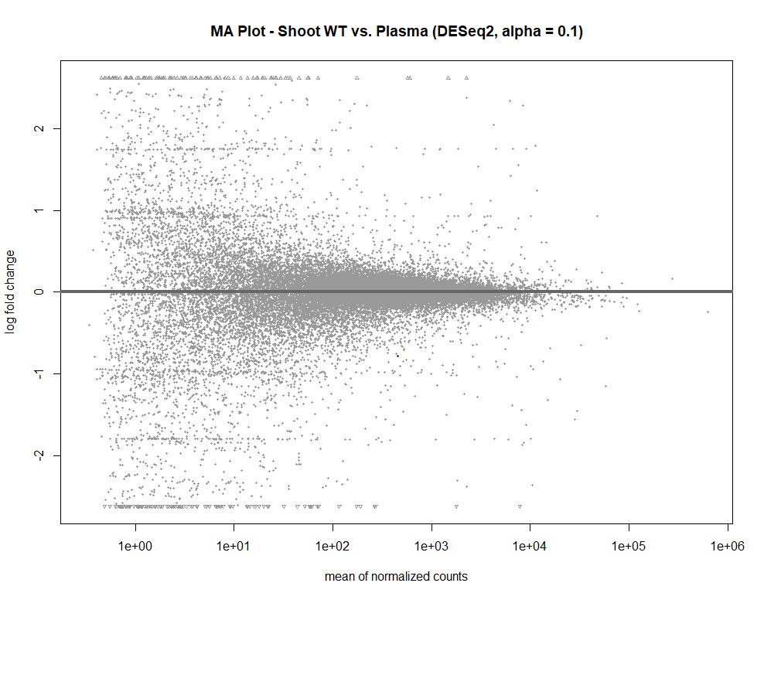
DESeq2 – MA Plots
(a) Seed WT/Dry
(b) Seed WT/Plasma
(c) Shoot WT/Plasma
Figure 6. MA plots of (a) seed WT/dry comparison, (b) seed WT/plasma comparison, and (c) shoot WT/plasma comparison.
Notes:
MA plot is a plot used to visualize gene expression differences between conditions. Each point on the plot represents a gene. The x-axis is the average expression level, and the y-axis is the log-fold change in gene expression between conditions.
The grey points represent genes that do not meet the criteria for differential expression, and the blue points highlight genes that are significantly differentially expressed. Again, we set the threshold to p-value greater than 0.05, and log2 fold change to be greater than 1 or less than -1.
Each subfigure represents one comparison. Only subfigures (a) and (b) have significantly differentially expressed genes, which aligns with our previous findings.

Slide 10
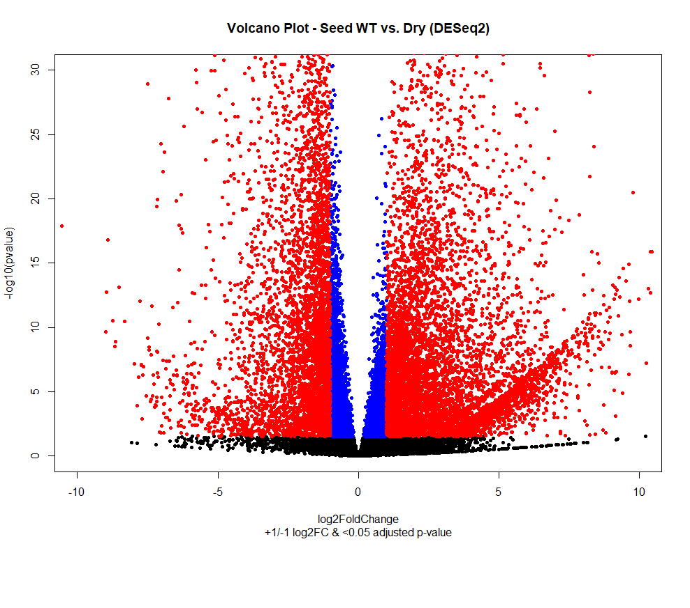
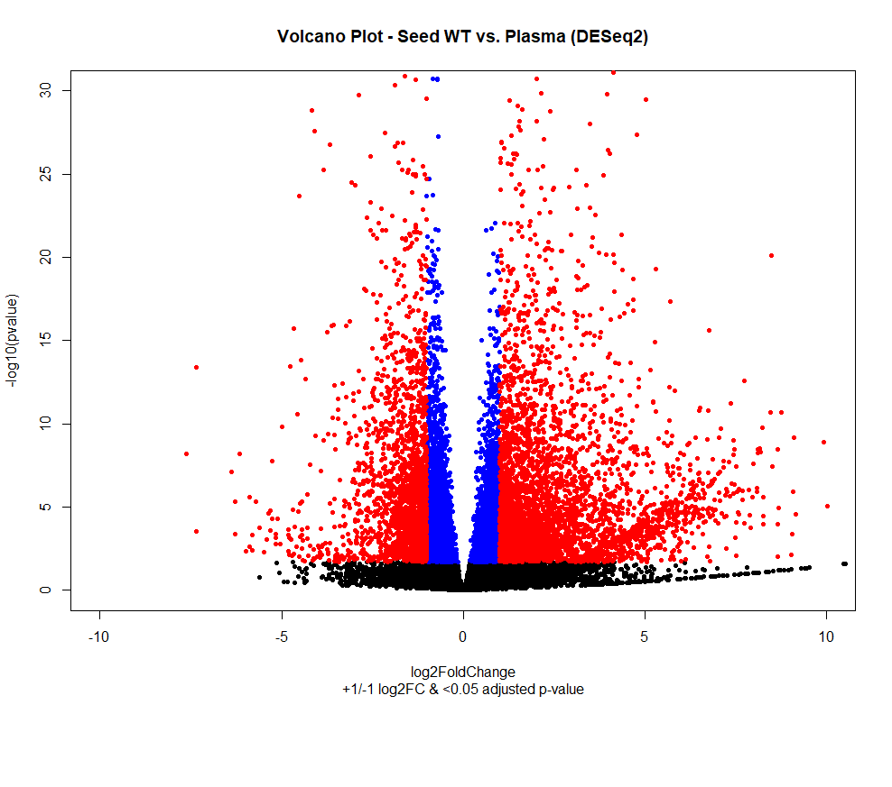
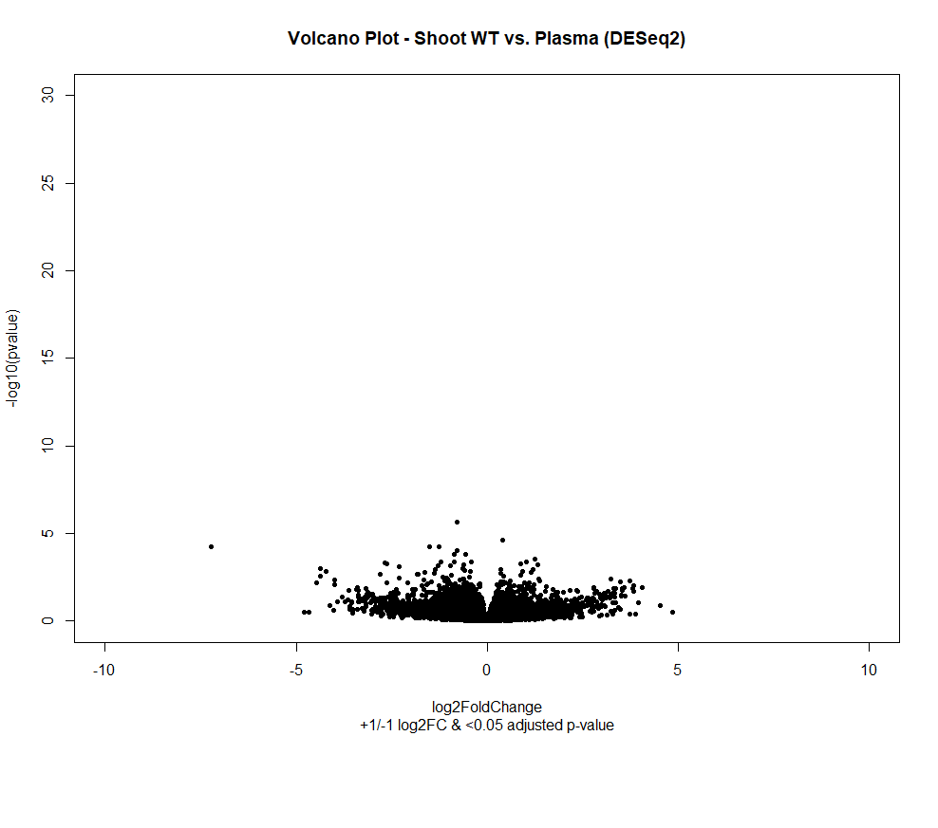
DESeq2 – Volcano Plots
(a) Seed WT/Dry
(b) Seed WT/Plasma
(c) Shoot WT/Plasma
Figure 7. Volcano plots of (a) seed WT/dry comparison, (b) seed WT/plasma comparison, and (c) shoot WT/plasma comparison.
Notes:
The volcano plot is just another type of plot to visualize the relationship between statistical significance and fold change of gene expression between two conditions. In these plots, each point represents a gene, with the x-axis indicating the log2 fold change and the y-axis representing the statistical significance, typically measured as the adjusted p-value.
There are 3 types of points in the volcano plots: black, blue and red. Black points represent genes that do not meet the criteria for differential expression. Blue points indicate genes with an adjusted p-value <0.05, while red points highlight genes that not only have an adjusted p-value <0.05 but also have a log2 fold change >1 or <-1. In other words, red points are the genes we are interested in, and they would be saved as up- and down-regulated gene lists for functional analysis.
Again, we could discover significantly differentially expressed genes in seed wild-type/dry and seed wild-type/plasma comparisons but not in shoot wild-type/plasma comparisons. The result of the volcano plot aligns with our previous finding.

Slide 11
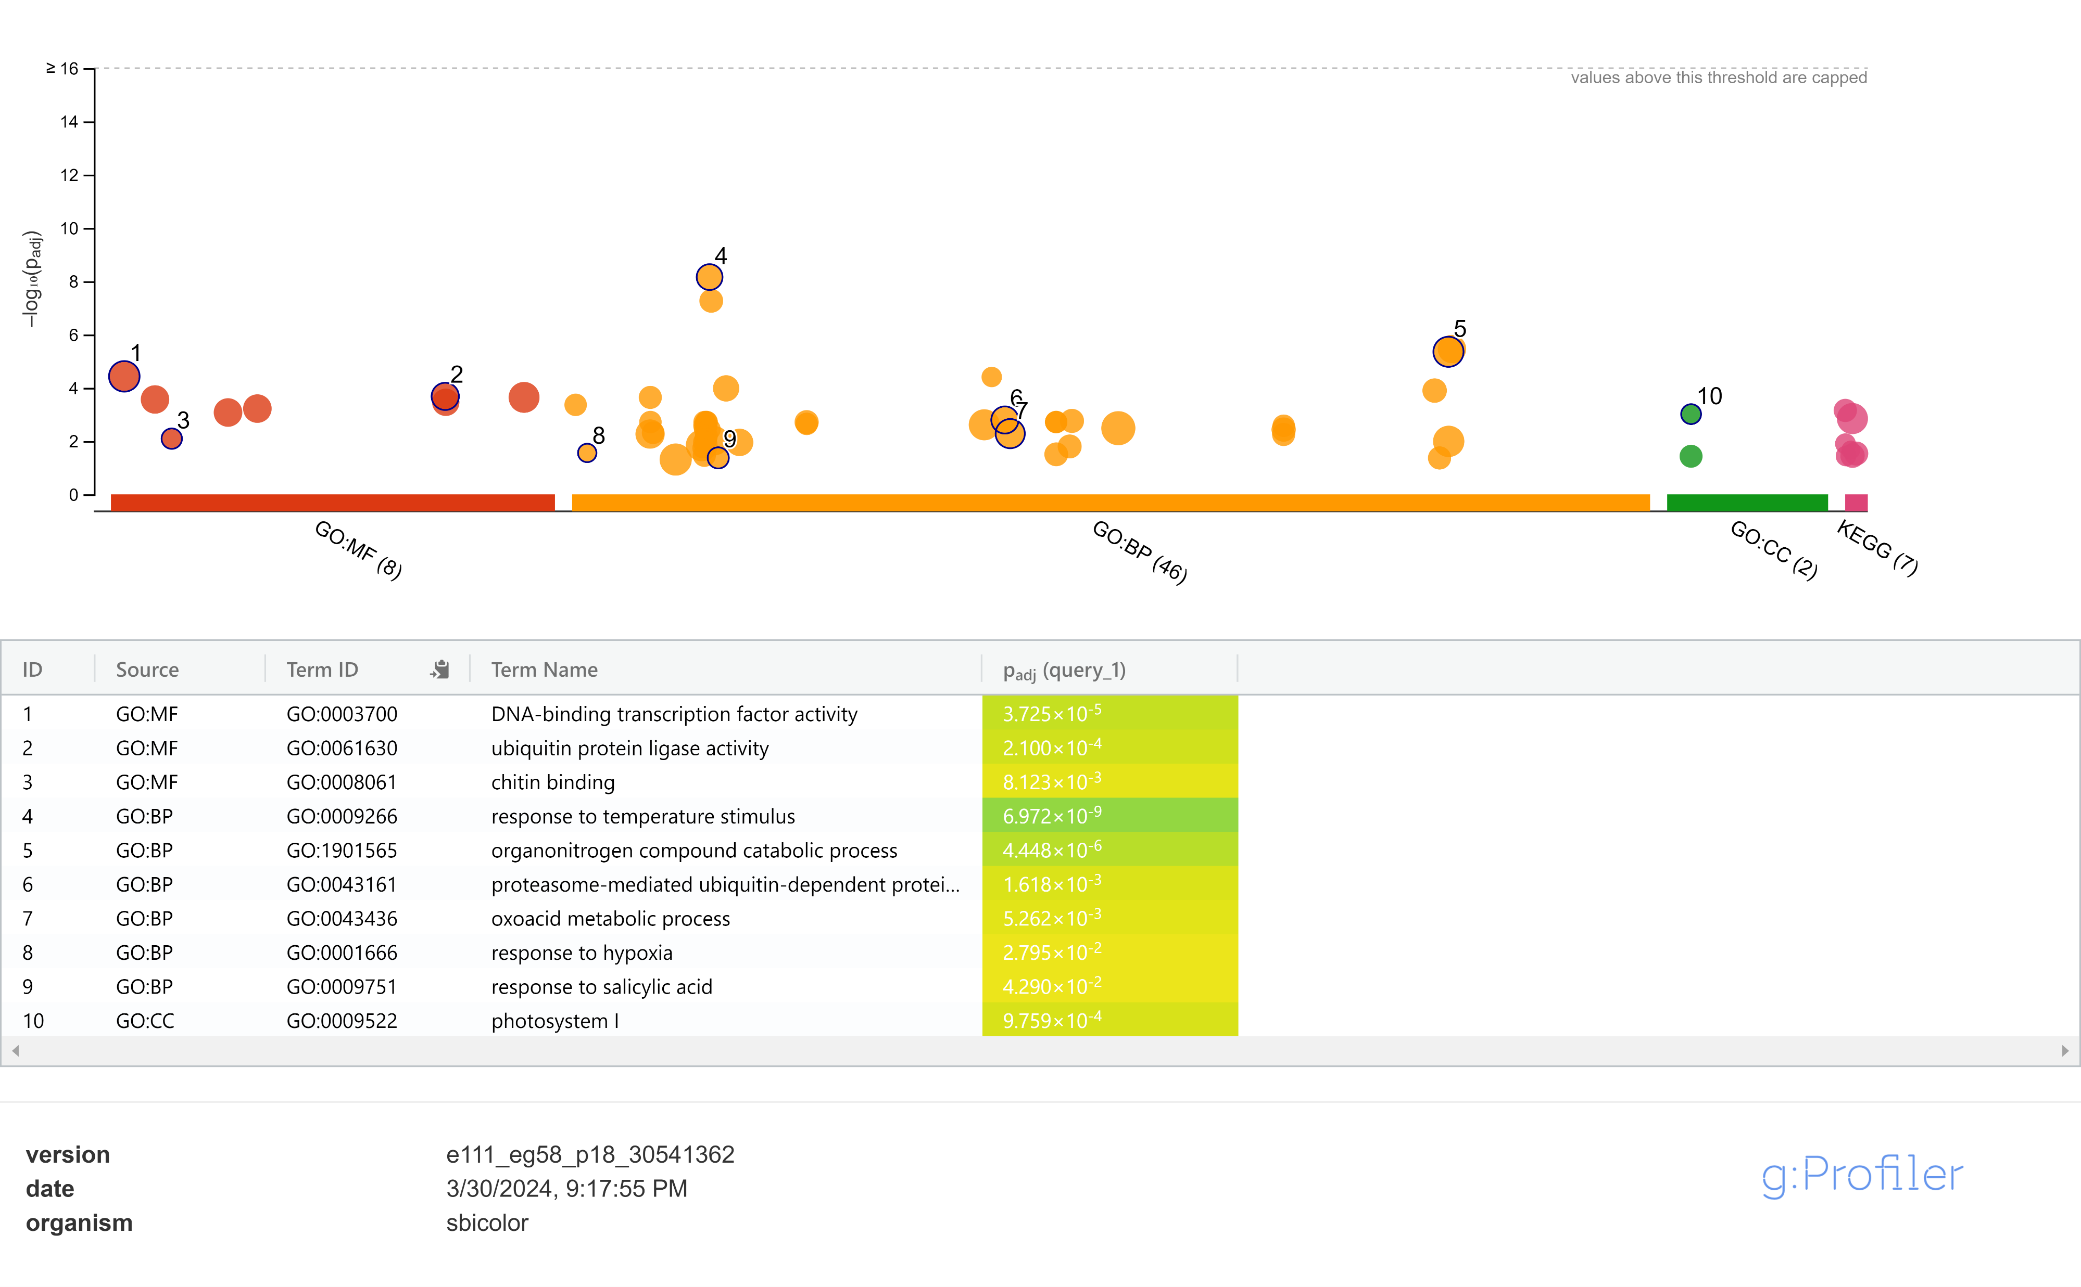
Functional Analysis – g:Profiler (Up-regulated)
Figure 8. g:Profiler result of up-regulated genes of seed WT/plasma comparison (Reimand et al., 2007).
Notes:
Next is the functional enrichment analysis. We only examine the seed wild-type plasma comparison because that’s what we are interested to. In the gProfiler result for up-regulated genes, some top gene ontology terms are like DNA-binding, response to temperature, photosystem. These might be the up-regulated pathways in plasma treatment.
Next is the functional enrichment analysis.
Since we were interested in the effect of plasma treatment on sorghum, we ignored the seed wild-type/dry comparison. We also ignored the shoot wild-type/plasma comparison because no genes were significantly differentially expressed. So, we would only examine the up and down-regulated genes in the seed wild-type/plasma comparison.
There are many tools to do the functional analysis. G:Profiler is one of the tools I used and will be presented here due to time. Other tools like agriGO and PlantRegMap are also useful functional analysis tools for agricultural species.
So, g:Profiler searches over your provided gene lists and gives you possible gene ontology terms (or so-called GO terms). This is what we got with the up-regulated gene list. There are GO terms like “DNA-binding transcription factor activity”, “ubiquitin protein ligase activity” and “chitin binding” highlight the regulatory and protein modification functions potentially involved in response to plasma treatment.
Terms like “response to temperature stimulus” and ”response to hypoxia” suggest adaptive responses to environmental cues induced by plasma treatment.
And terms like “proteasome-mediated ubiquitin-dependent protein” and ”oxoacid metabolic process” underscores the involvement of protein degradation and metabolic processes in the cellular response to plasma treatment

Slide 12
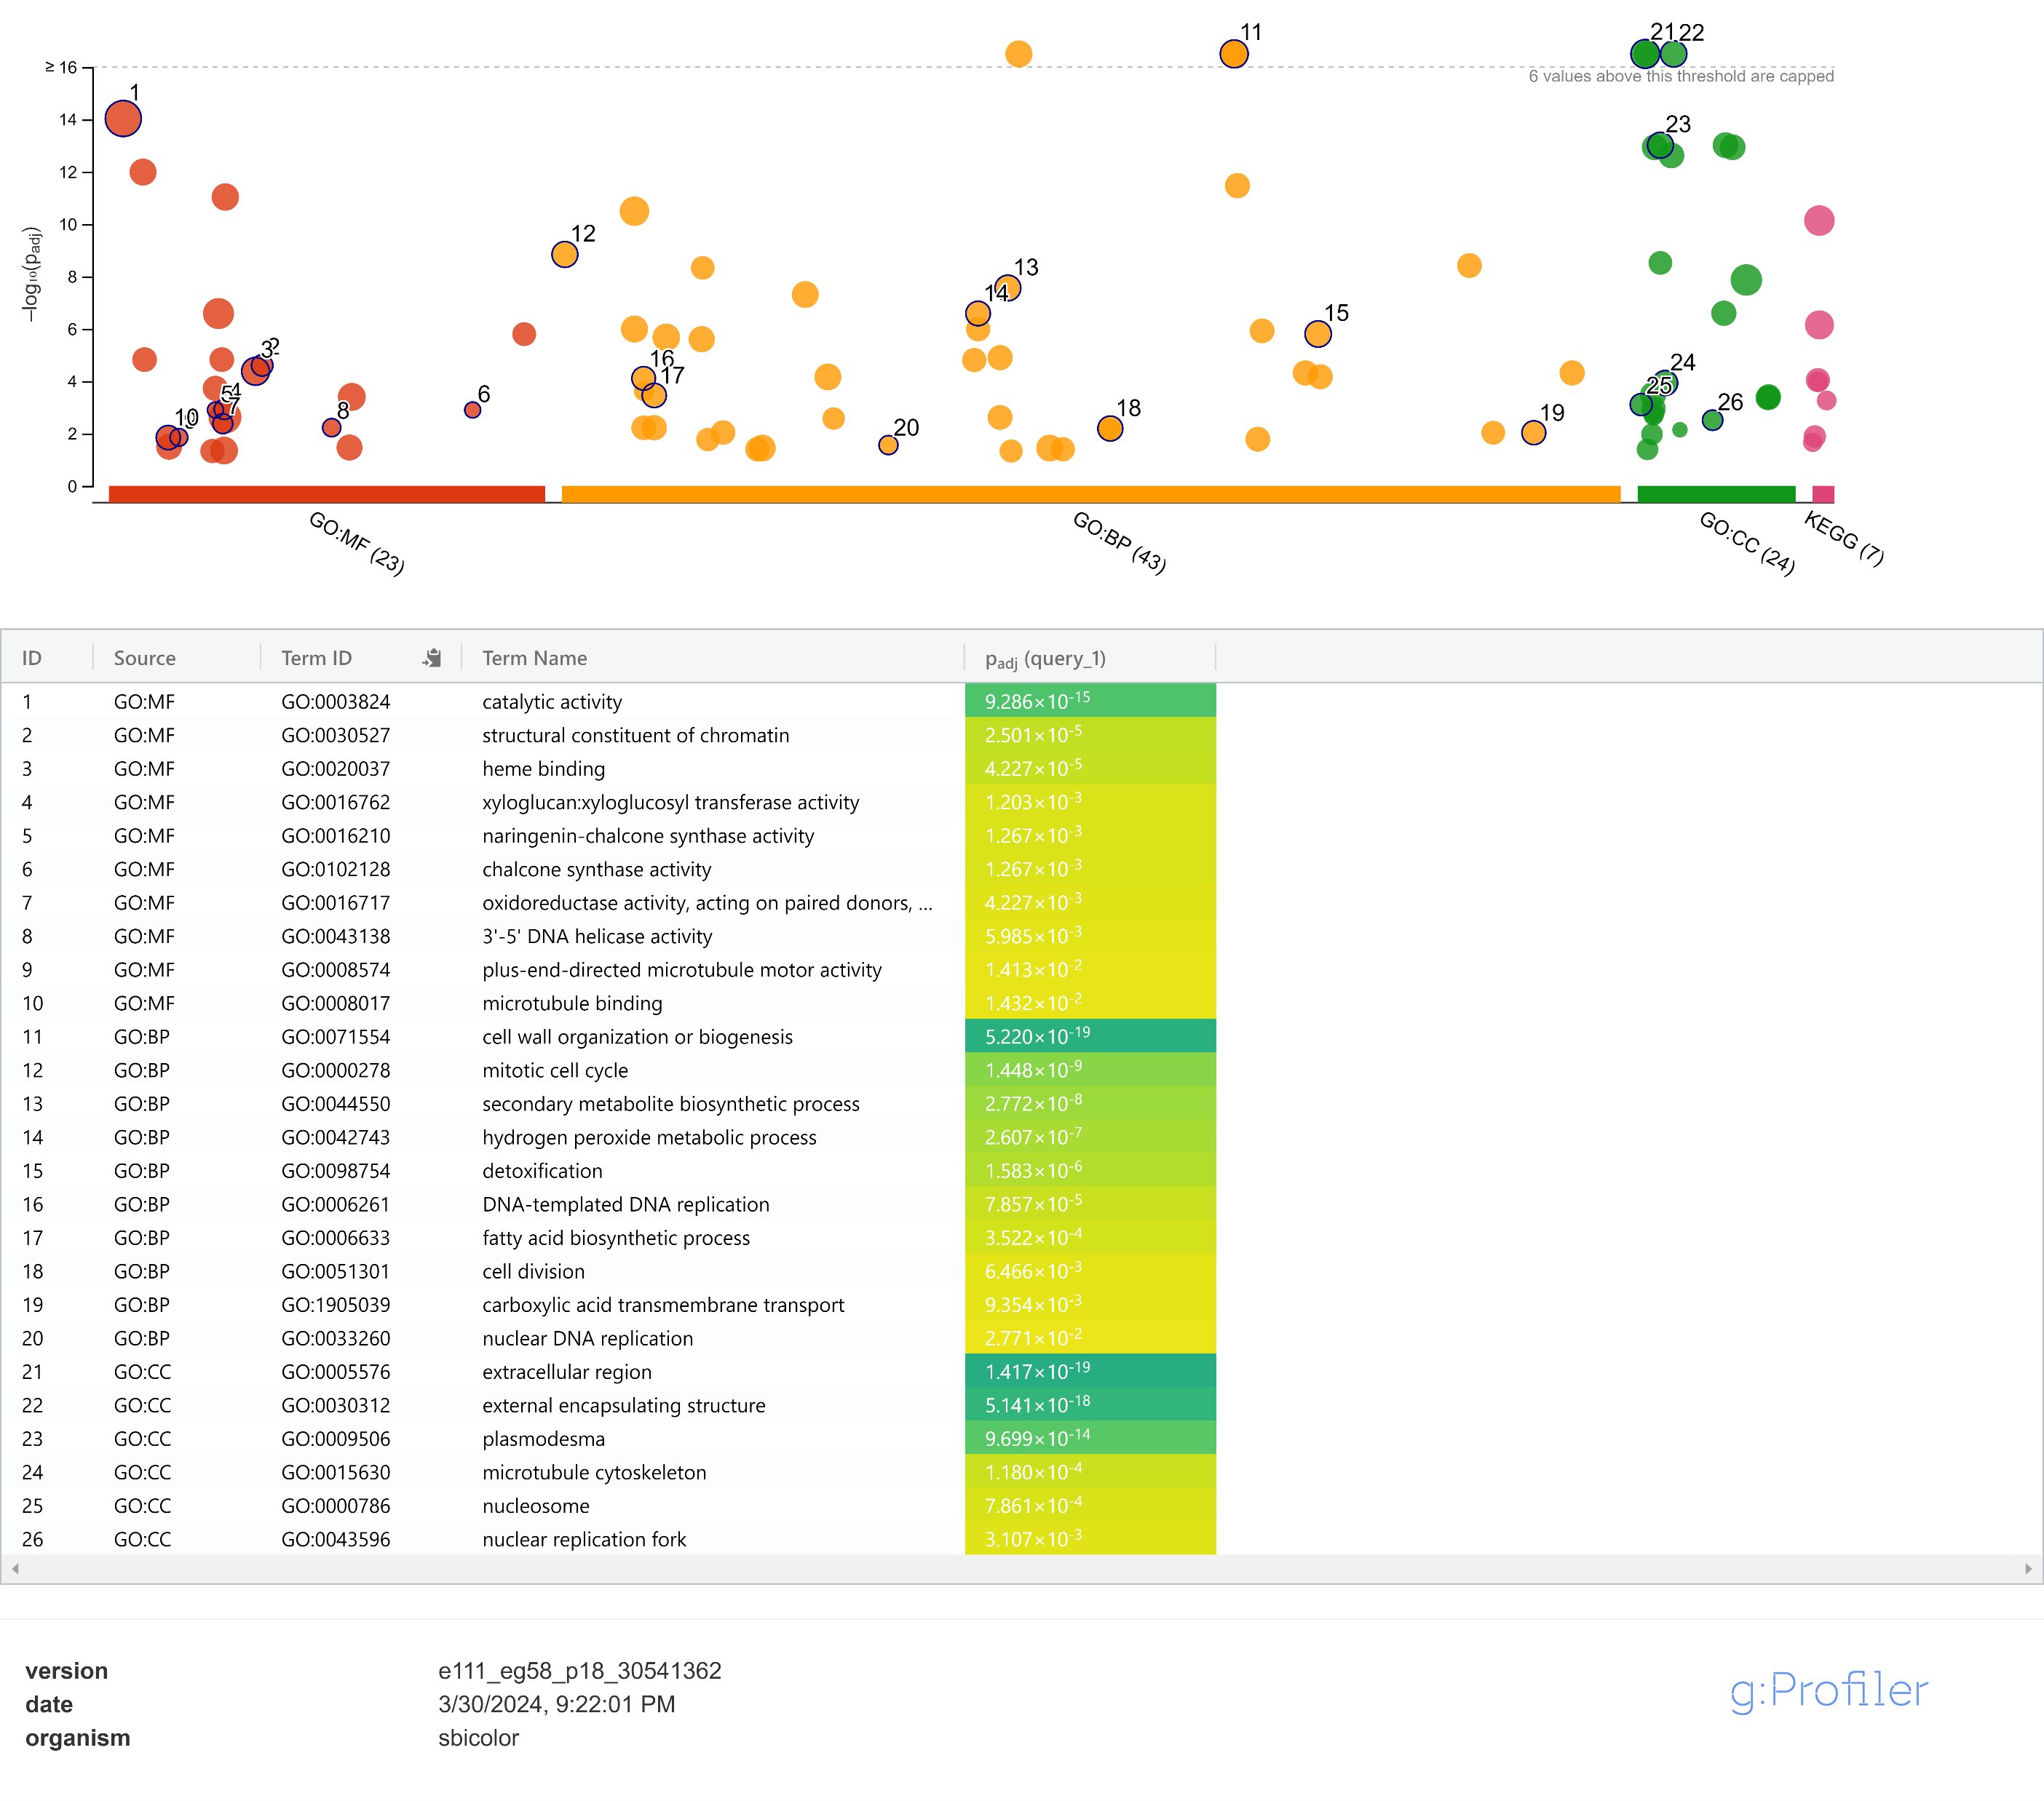
Functional Analysis – g:Profiler (Down-regulated)
Figure 9. g:Profiler result of down-regulated genes of seed WT/plasma comparison (Reimand et al., 2007).
Notes:
In the gProfiler result for down-regulated genes, some top GO terms are catalytic activity, cell wall, extracellular region. These might be the down-regulated pathways in plasma treatment.
Figure 9 shows the gProfiler result of down-regulated genes between the Seed WT and seed plasma condition.
Among the top GO terms, ”catalytic activity,” ”structural constituent of chromatin,” and ”heme binding” highlight functional roles related to enzymatic activities and chromatin organization.
Additionally, terms such as ”cell wall organization or biogenesis,” ”mitotic cell cycle,” and ”secondary metabolite biosynthetic process” indicate perturbations in cellular processes and metabolic pathways associated with plasma treatment-induced gene downregulation.
GO terms such as ”extracellular region” and ”microtubule cytoskeleton” suggest cellular organization and extracellular matrix composition alterations in response to plasma treatment.

Slide 13


eFP Browser – TPM Normalization
$$TPM= \frac{n_{g}}{N∙l_{g}}\left({10}^{3}\right)\left({10}^{6}\right)$$
$n_{g}$ Number of reads/fragments for the gene
$N$ Sum of reads/fragments
$l_{g}$ Length of the gene
Wagner et al., 2012
Notes:
The eFP (electronic Fluorescent Pictograph) browser is a useful tool for visualizing gene expression data.
But first, we need to prepare the TPM counts. TPM stands for transcripts per million. It’s calculated with the number of reads for each gene, the sum of reads and gene lengths.
The calculated TPM values in the eFP browser allow researchers to observe spatial and temporal gene expression patterns across various tissues and developmental stages.

Slide 14
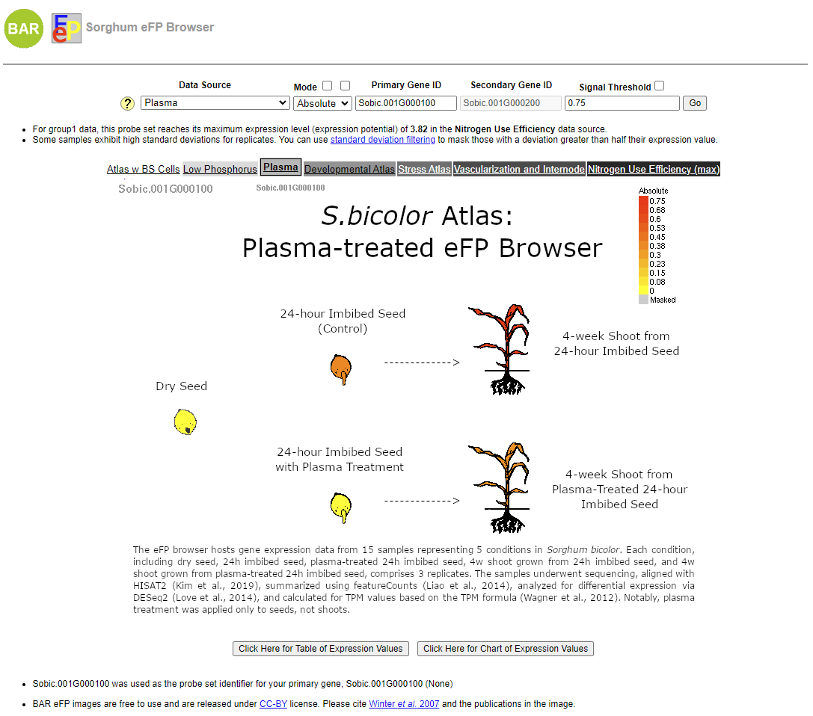
eFP Browser Visualization
Figure 10. eFP browser (Winter et al., 2007).
Notes:
Here’s a picture of the actual eFP browser.
You can select the data source here. Mine is the plasma atlas.
You can input the gene ID here and then press GO. The current searching gene ID is also shown here.
The image shows five conditions: dry seed, imbibed seed, plasma-treated seed, shoot, and plasma-treated shoot. The colour legend is placed at the top right. Red indicates high gene expression levels, and yellow indicates low or negligible gene expression. Each condition shows a different colour, indicating the gene expression in that condition.
In this gene, sobic.001G000100, the gene expression in dry and plasma-treated seeds is low or negligible. Seed and plasma-treated shoots have higher gene expression. Wild-type shoots have the highest gene expression.
If you want to see the gene expression by numbers, you can click this button.
And if you want to see a bar chart of gene expression levels, click here.

Slide 15
References
Liao, Yang, Gordon K Smyth, and Wei Shi (2014). “featureCounts: an efficient general purpose program for assigning sequence reads to genomic features”. In: Bioinformatics 30.7, pp. 923–930.
Love, Michael I, Wolfgang Huber, and Simon Anders (2014). “Moderated estimation of fold change and dispersion for RNA-seq data with DESeq2”. In: Genome biology 15.12, pp. 1–21.
McCormick, Ryan F et al. (2018). “The Sorghum bicolor reference genome: improved assembly, gene annotations, a transcriptome atlas, and signatures of genome organization”. In: The Plant Journal 93.2, pp. 338–354.
Pertea, Mihaela et al. (2016). “Transcript-level expression analysis of RNA-seq experiments with HISAT, StringTie and Ballgown”. In: Nature protocols 11.9, pp. 1650–1667.
R Core Team (2021). R: A Language and Environment for Statistical Computing. R Foundation for Statistical Computing. Vienna, Austria. url: https://www.R-project.org/.
Reimand, J¨uri et al. (2007). “g: Profiler—a web-based toolset for functional profiling of gene lists from large-scale experiments.” In: Nucleic acids research 35.suppl 2, W193–W200.
Wagner, G¨unter P, Koryu Kin, and Vincent J Lynch (2012). “Measurement of mRNA abundance using RNA-seq data: RPKM measure is inconsistent among samples.” In: Theory in biosciences 131, pp. 281–285.
Winter, Debbie et al. (2007). “An “Electronic Fluorescent Pictograph” browser for exploring and analyzing large-scale biological data sets”. In: PloS one 2.8, e718.
Notes:
Here are the references. If you have any questions, please feel free to ask. Thank you!

